Slide 1
CRYPTOGRAPHY SIMULATION WITH MBEDTLS\OpenSSL LIBRARY USAGE AND USER INTERACTION
Under the guidance of:
Prof. Bannamma Patil

Slide 2
Contents:
Introduction
Objectives
Implementation
Language Specification
Advantages
Process flow
Reference
Future Scope
Output
Conclusion

Slide 3
Introduction:
In today’s digital age, the security of communication
channels is paramount. With the increasing frequency of
cyber-attacks and data breaches, ensuring that sensitive
information remains confidential. Cryptographic
techniques provide the necessary tools to achieve this b
providing secure communication by encrypting data and
verifying the identities of communicating parties.
Our project aims to explore and implement cryptographic solutions using well-known libraries, mbedTLS and OpenSSL, to secure a custom communication protocol between a patient and an AI psychologist, named ELIZE. The objective is to simulate a real-world scenario where secure communication is essential, demonstrating the practical application of cryptographic principles.

Slide 4
OBJECTIVES:
General Digital Certificates:
Create a self-signed root certificates.
Generate and sign user certificates for Alice and Bob using root certificate.
Develop a Crypto Wrapper:
Implement a basic cryptographic wrapper using mbedTLC or OpenSSL.
Perform encryption, decryption, signing and verification operations.
Secure the Communication Protocol:
Implement a secure communication protocol between the patient and ELIZE.
Ensure all messages are encrypted and signed to guarantee confidentiality and authenticity.

Slide 5
IMPLEMENTATION:
Securing a Custom Protocol
We will be securing a custom communication protocol between two parties.
Our job is to secure the traffic.
There are two phases:
Basic implement crypto wrapper and make the crypto unit-test pass.
Advanced secure the protocol using your crypto wrapper implementation.

Slide 6
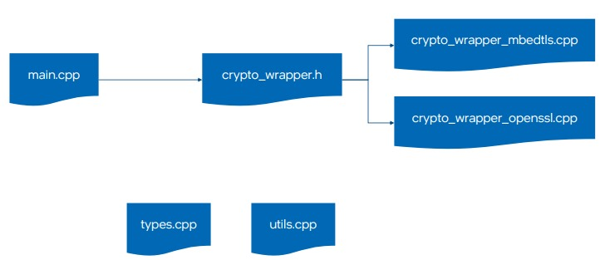
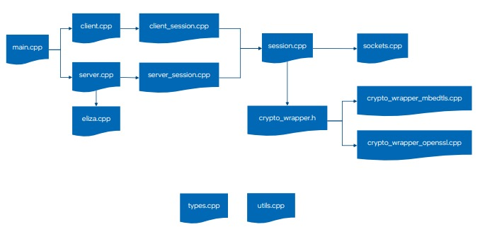

Slide 7
Encryption and decryption:
Encryption is the process of converting plain, readable data (plaintext) into an encoded format (ciphertext) that can only be read or decrypted by someone who possesses the appropriate decryption key. Encryption is used to ensure the confidentiality of data, protecting it from unauthorized access, even if the data is intercepted or accessed by unauthorized individuals.
The decryption process is the reverse of encryption. It involves converting the ciphertext back to plaintext using the appropriate decryption key

Slide 8
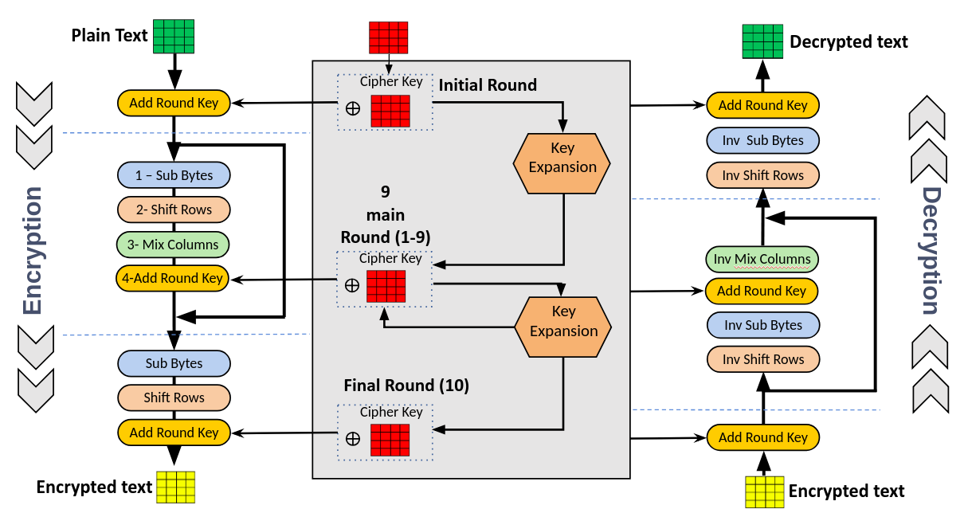

Slide 9
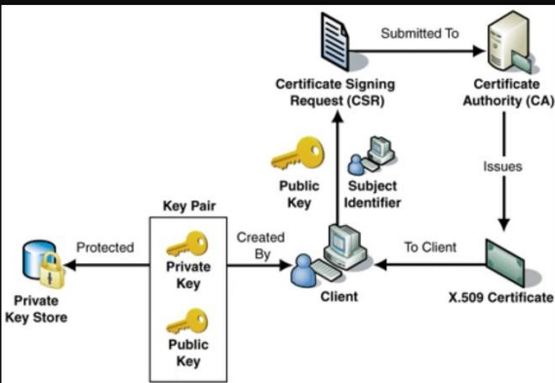
Process flow:

Slide 10
LANGUAGE SPECIFICATION:
Programming Language
C: The primary programming language used for implementing the cryptographic wrapper, unit test, and secure communication protocol.
Cryptographic Libraries
mbedTLC: Provides a wide range of cryptographic primitives and protocols.
OpenSSL: A robust full-featured open-source toolkit implementing SSL/TLS protocols and various cryptographic algorithms.
Language Standards
C99: The project adheres to the C99 standard of the C programming language.

Slide 11
ADVANTAGES:
Enhanced Security
Data Confidentiality
Data Integrity
Authentication
Hands-on Cryptographic Experience
Practical Skills
Real-world Application
Modular and Reusable Code
Crypto Wrapper
Unit tests
Robust Communication Protocol
Secure Messaging
Protocol Design

Slide 12
Interoperability
Cross-Platform Compatibility
Standard Protocols
Performance Optimization
Efficient Algorithms
Profiling and Optimization
User Interaction and Usability
User-Friendly Interface
Clear Feedback
Scalability and Flexibility
Scalable Design
Flexibility

Slide 13
REFERENCE:
BOOKS:
“Cryptography and Network Security: Principles and Practice” by William Stallings
“Applied Cryptography: Protocols, Algorithms, and Source Code in C” by Bruce Schneier.
“computer Security: Art and Science” by Matt Bishop
ONLINE DOCUMENATION AND TUTORIALS:
OpenSSL Documentation
mbedTLC Documentation
OpenSSL Wiki
mbedTLC Tutorials

Slide 14
Research Papers and Articles
“The OpenSSL Project” by the OpenSSL Project Team
“A Survey of Cryptographic Libraries for Embedded Systems” by Daniel J. Bernstein, et al.
Online Courses and Lectures
Coursera: Cryptography by Standard University
edX : Cybersecurity Fundamentals by Rochester Institute of Technology
Youtube: Computerphile Cryptography Series
Code Repositories and Examples
GitHub: OpenSSL Examples
GitHub: mbedTLS Examples
GitHub: Cryptographic Wrappers

Slide 15
FUTURE SCOPE:
Enhanced Security Features
Post-Quantum Cryptography
Advanced authentication Mechanisms
Zero-Knowledge Proofs
Performance optimization
Hardware Acceleration
Efficient Algorithms
Scalability and Deployment
Cloud Integration
Distributed Systems

Slide 16
Interoperability and Standardization
Standard Protocols
Cross-Platform Support
User Experience and Accessibility
User Interface Enhancements
Accessibility Features
Extended Functionality
Data Analytics and AI Integration
Real-Time Monitoring and Alerts

Slide 17
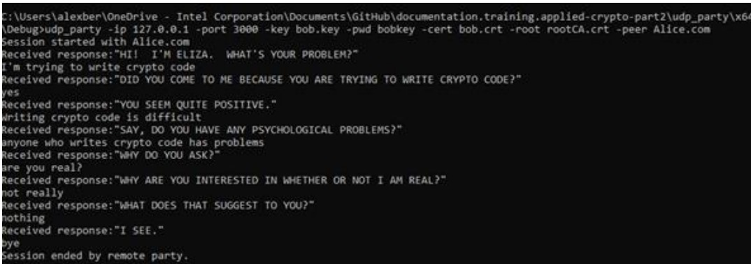
Output:

Slide 18
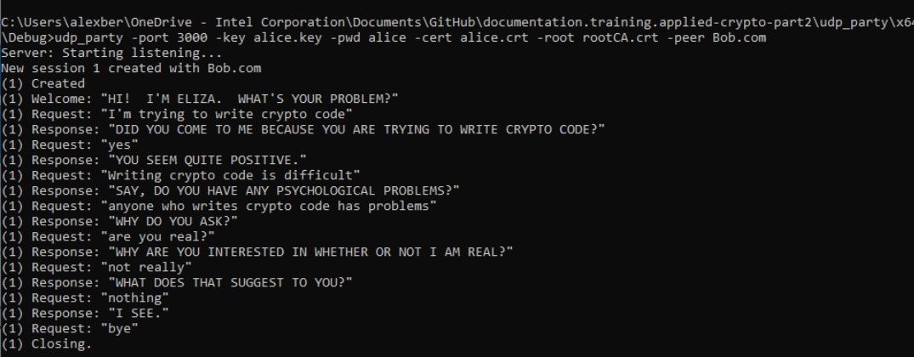

Slide 19
CONCLUSION:
Our project successfully demonstrates implementation of
a secure communication protocol between a patient and
an AI psychologist(ELIZA) using cryptographic libraries
such as mbedTLC and OpenSSL. By focusing on key
Cryptographic principles, the project ensures that the
communication remains confidential, authentic, and
Intact throughout the interaction.

Slide 20
Team Members And Contributions:
Team leader :Mitali.M.Kumane
Member 1: Rehana Banu
We have worked on project report , making presentation and github repository.
We worked on coding part and modifications.
We as a team have worked greatly on this project with a coordination and our mentor’s support

Slide 21
thank you

